Slide 1
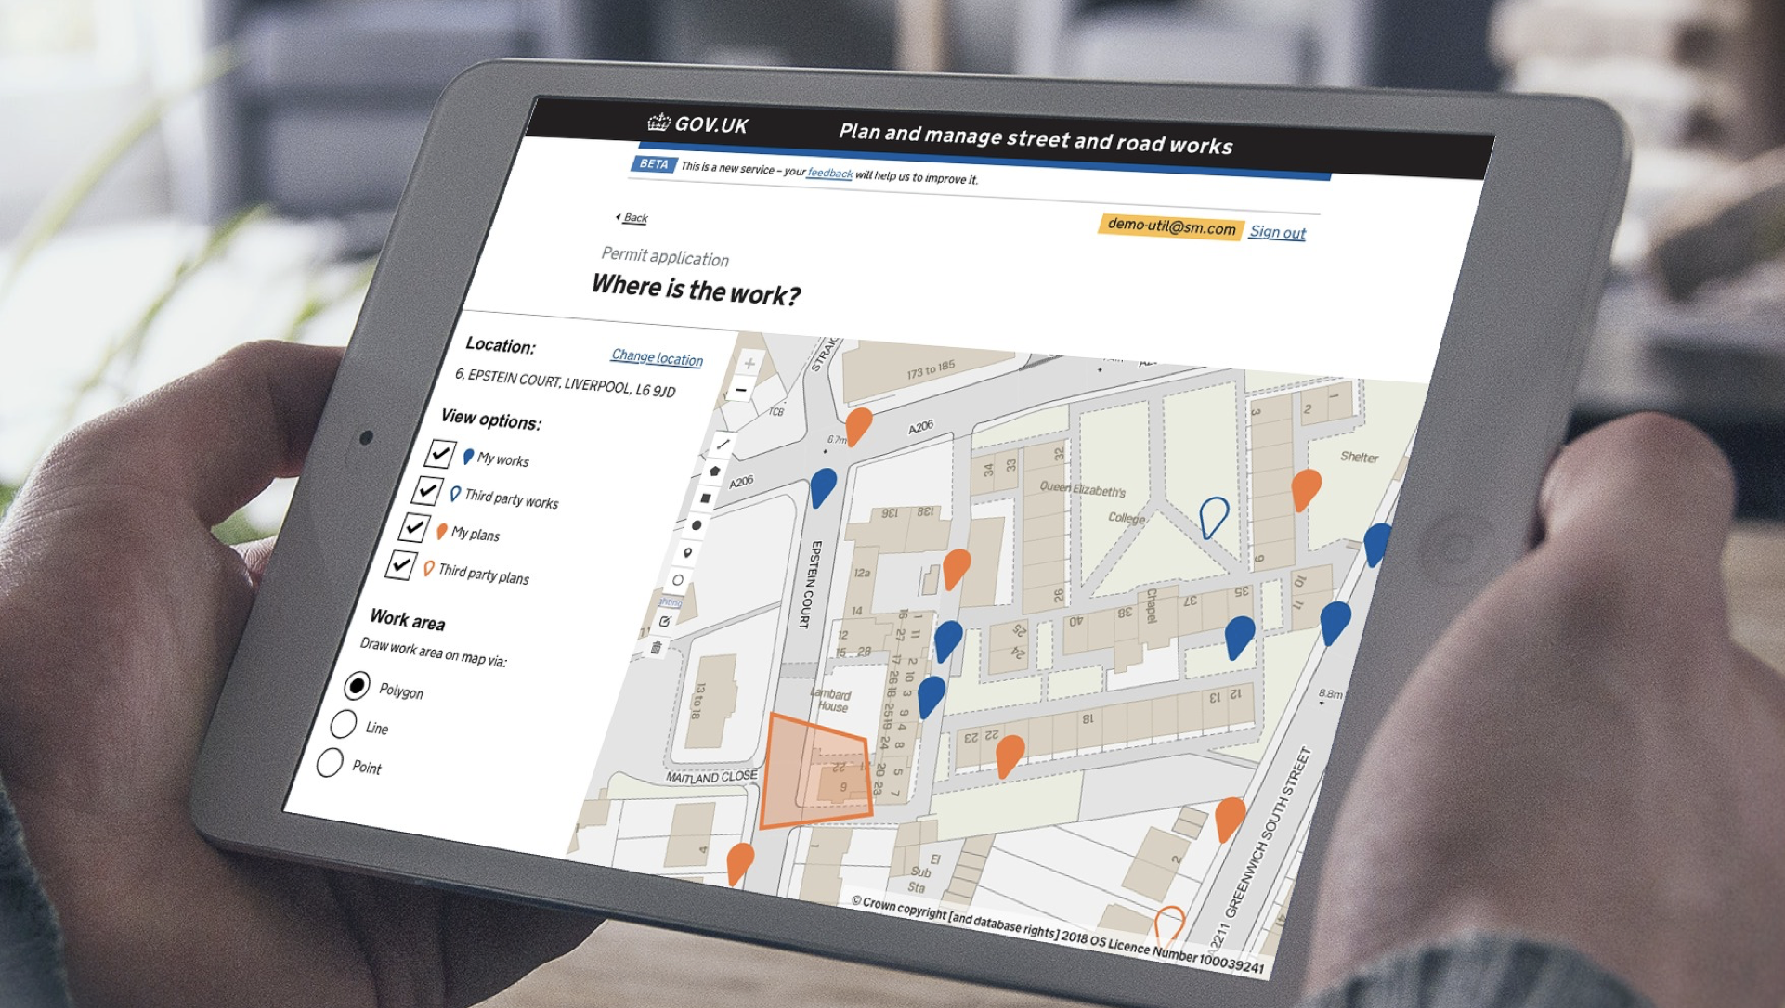

Street Manager High-level roadmap
@ Crown copyright

Slide 2
Contents
Introduction and guidance
Roadmap: Early adoption via User Interface (UI)
Roadmap: Mid-Public Beta adoption via UI
Roadmap: Late adoption via UI
Roadmap: Early adoption via API
Roadmap: Mid-Public Beta adoption via API
Roadmap: Late adoption via API

Slide 3
Introduction and guidance
Introduction: This document provides indicative roadmaps for Street Manager adoption. Options are available for 6 different scenarios based on timing of transition (early, mid-Public beta, and late) and adoption method (API vs UI). You will need to move around, edit the description and duration of existing activities and add new ones to fit with your individual circumstances.
Notes:
The following slides simply provide examples of indicative timelines, the actual timelines will depend on your organisation's requirements. There is no set date for Go-live or transition completion – this is entirely up to you, as long as done prior to the March 2020 deadline.
All of the activities currently listed will need to be performed one way or another to ensure successful transition but how and when is up to you and your organisation.
Best practice: Pick and update the relevant slide for your organisation as soon as possible to inform more detailed delivery plan and actions, but treat this as a live document and make sure it is updated throughout the lifecycle of the project. Use the initial version as a baseline to enable discussions around deviations and slippage from initial plan.

Slide 4
Roadmap - UI option
Early transition
Indicative roadmap - move around and edit activities and their duration where needed to align to your individual circumstances
Complete
In progress
Not started
Tech dependency
Stream | Private beta
 | May | Jun | Jul | Aug | Sep | Oct
Technical adoption
Business change
Check you’re using a supported browser
Provide DfT with user details
Agree to terms of use for test environment
Receive user logins for test environment
Test system and provide feedback
Inform DfT when you want to move to production
Provide details for additional users
Agree T&C and charging model
GO-
LIVE
Impact and readiness assessment
Business case sign-off
Develop delivery plan
Define benefits and KPIs
Update processes where needed
Second iteration of readiness assessment
Final readiness assessment
Monitor delivery against plan, manage risks and issues and track benefits and KPIs
Stakeholder analysis
Develop stakeholder strategy
Engage key stakeholders
Engage key stakeholders to secure buy-in and support
Review sentiments
Engage all stakeholders to ensure they are aware of the changes, their role and what that means to them
Deliver training to testers
Deliver training to all users: system, processes and ways of working

Slide 5
Roadmap - UI option
mid-Public beta transition
Indicative roadmap - move around and edit activities and their duration where needed to align to your individual circumstances
Complete
In progress
Not started
Tech dependency
Stream | Private beta |  |  |  |  |  | Public beta
 | May | Jun | Jul | Aug | Sep | Oct | Nov | Dec
Technical adoption
Business change
Check you’re using a supported browser
Provide DfT with user details
Agree to terms of use for test environment
Receive user logins for test environment
Test system and provide feedback
Inform DfT when you want to move to production
Provide details for additional users
Agree T&C and charging model
GO-
LIVE
Impact and readiness assessment
Business case sign-off
Develop delivery plan
Define benefits and KPIs
Update processes where needed
Second iteration of readiness assessment
Final readiness assessment
Monitor delivery against plan, manage risks and issues and track benefits and KPIs
Stakeholder analysis
Develop stakeholder strategy
Engage key stakeholders
Engage key stakeholders to secure buy-in and support
Review sentiments
Engage all stakeholders to ensure they are aware of the changes, their role and what that means to them
Deliver training to testers
Deliver training to all users: system, processes and ways of working

Slide 6
Roadmap - UI option
Late transition
Indicative roadmap - move around and edit activities and their duration where needed to align to your individual circumstances
Complete
In progress
Not started
Tech dependency
Stream | Private beta |  |  |  |  |  | Public beta
 | May | Jun | Jul | Aug | Sep | Oct | Nov | Dec | Jan | Feb | Mar
Technical adoption
Business change
Check you’re using a supported browser
Provide DfT with user details
Agree to terms of use for test environment
Receive user logins for test environment
Test system and provide feedback
Inform DfT when you want to move to production
Provide details for additional users
Agree T&C and charging model
GO-
LIVE
Impact and readiness assessment
Business case sign-off
Develop delivery plan
Define benefits and KPIs
Update processes where needed
Second iteration of readiness assessment
Final readiness assessment
Monitor delivery against plan, manage risks and issues and track benefits and KPIs
Stakeholder analysis
Develop stakeholder strategy
Engage key stakeholders
Engage key stakeholders to secure buy-in and support
Review sentiments
Engage all stakeholders to ensure they are aware of the changes, their role and what that means to them
Deliver training to testers
Deliver training to all users: system, processes and ways of working

Slide 7
Roadmap - API option
mid-Public beta transition
Indicative roadmap - move around and edit activities and their duration where needed to align to your individual circumstances
Complete
In progress
Not started
Tech dependency
Stream | Private beta |  |  |  |  |  | Public beta
 | May | Jun | Jul | Aug | Sep | Oct | Nov | Dec
Technical adoption
Business change
Familiarise yourself with the API docs
Plan how to make systems API compatible
Request API access from DfT
Agree T&C for sandbox
Develop IT in-house / engage with IT supplier
Test API in sandbox environment
Inform DfT when you want to move to production
Agree T&C and charging model
Move to production and ensure accuracy of data submitted
If using an EToN vendor, review options, agree timelines and decide if an upgrade is needed
GO-
LIVE
Impact and readiness assessment
Business case sign-off
Develop delivery plan
Define benefits and KPIs
Update processes where needed
Second iteration of readiness assessment
Final readiness assessment
Monitor delivery against plan, manage risks and issues and track benefits and KPIs
Stakeholder analysis
Develop stakeholder strategy
Engage key stakeholders
Engage key stakeholders to secure buy-in and support
Review sentiments
Engage all stakeholders to ensure they are aware of the changes, their role and what that means to them
Deliver training to testers
Deliver training to all users: system, processes and ways of working

Slide 8
Roadmap - API option
Early transition
Indicative roadmap - move around and edit activities and their duration where needed to align to your individual circumstances
Complete
In progress
Not started
Tech dependency
Stream | Private beta
 | May | Jun | Jul | Aug | Sep | Oct
Technical adoption
Business change
Familiarise yourself with the API docs
Plan how to make systems API compatible
Request API access from DfT
Agree T&C for sandbox
Develop IT in-house / engage with IT supplier
Test API in sandbox environment
Inform DfT when you want to move to production
Agree T&C and charging model
Move to production and ensure accuracy of data submitted
If using an EToN vendor, review options, agree timelines and decide if an upgrade is needed
GO-
LIVE
Impact and readiness assessment
Business case sign-off
Develop delivery plan
Define benefits and KPIs
Update processes where needed
Second iteration of readiness assessment
Final readiness assessment
Monitor delivery against plan, manage risks and issues and track benefits and KPIs
Stakeholder analysis
Develop stakeholder strategy
Engage key stakeholders
Engage key stakeholders to secure buy-in and support
Review sentiments
Engage all stakeholders to ensure they are aware of the changes, their role and what that means to them
Deliver training to testers
Deliver training to all users: system, processes and ways of working

Slide 9
Roadmap - API option
Late transition
Indicative roadmap - move around and edit activities and their duration where needed to align to your individual circumstances
Complete
In progress
Not started
Tech dependency
Stream | Private beta |  |  |  |  |  | Public beta
 | May | Jun | Jul | Aug | Sep | Oct | Nov | Dec | Jan | Feb | Mar
Technical adoption
Business change
Familiarise yourself with the API docs
Plan how to make systems API compatible
Request API access from DfT
Agree T&C for sandbox
Develop IT in-house / engage with IT supplier
Test API in sandbox environment
Inform DfT when you want to move to production
Agree T&C and charging model
Move to production and ensure accuracy of data submitted
If using an EToN vendor, review options, agree timelines and decide if an upgrade is needed
GO-
LIVE
Impact and readiness assessment
Business case sign-off
Develop delivery plan
Define benefits and KPIs
Update processes where needed
Second iteration of readiness assessment
Final readiness assessment
Monitor delivery against plan, manage risks and issues and track benefits and KPIs
Stakeholder analysis
Develop stakeholder strategy
Engage key stakeholders
Engage key stakeholders to secure buy-in and support
Review sentiments
Engage all stakeholders to ensure they are aware of the changes, their role and what that means to them
Deliver training to testers
Deliver training to all users: system, processes and ways of working

